Slide 1
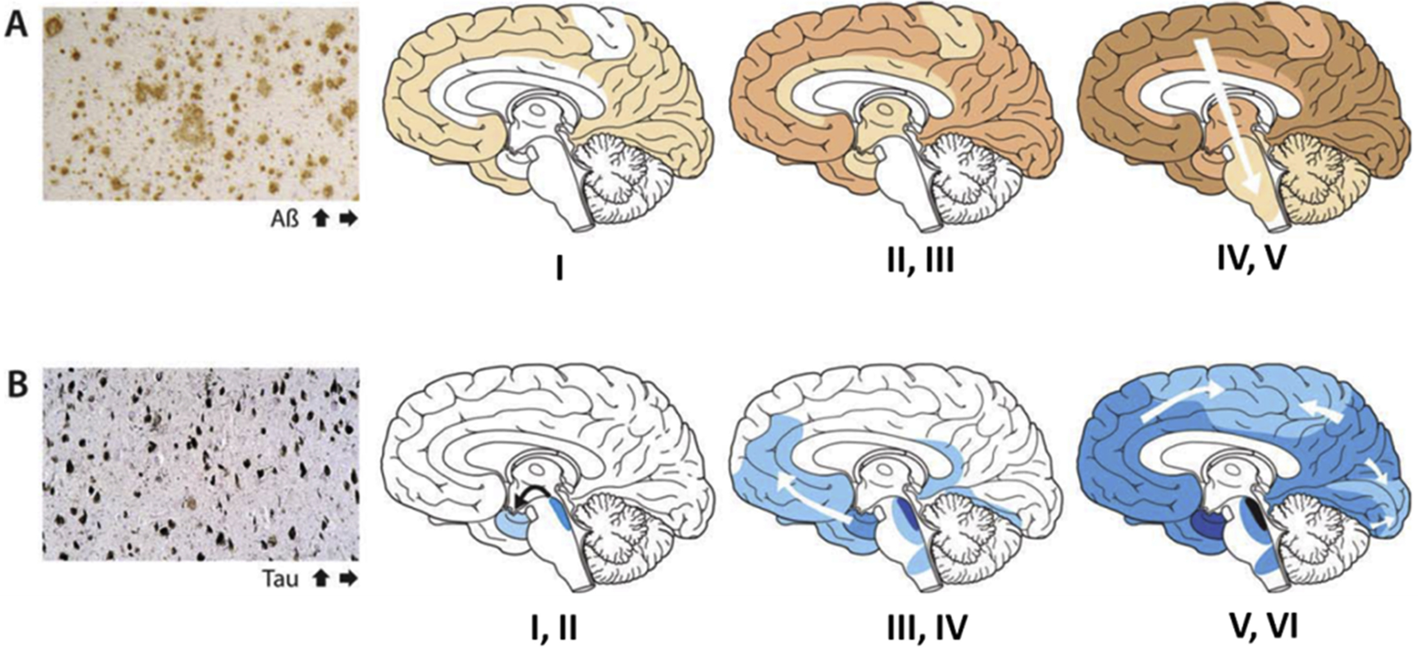
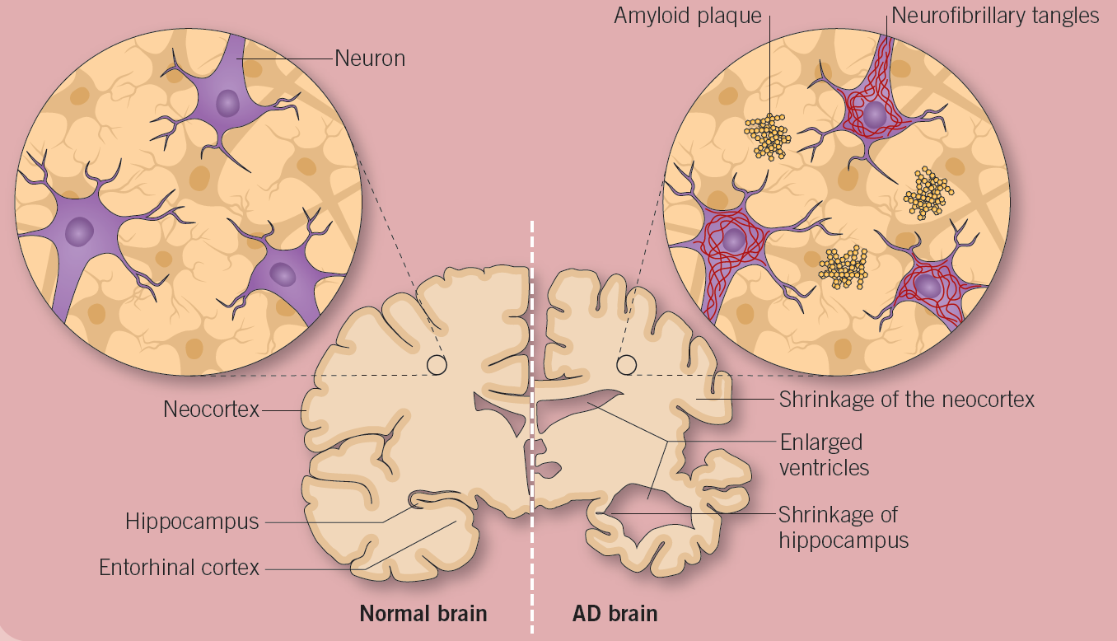

Slide 2
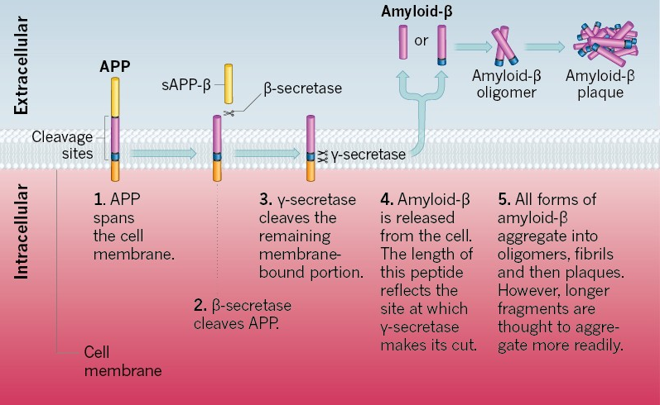
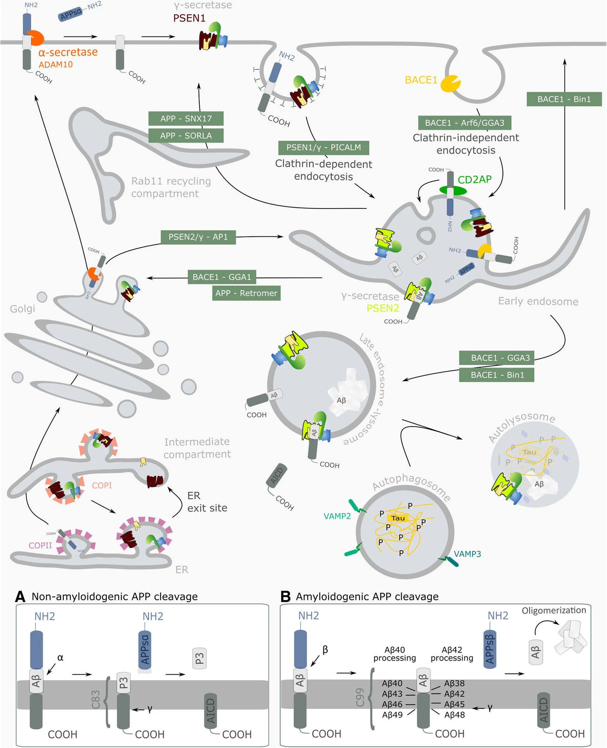

Slide 3
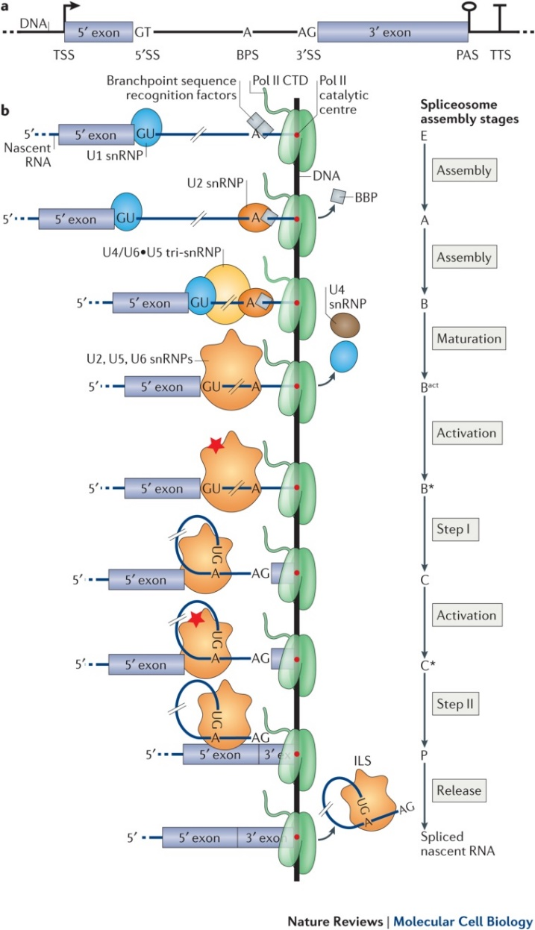

Slide 4
Whole Transcriptome
Targeted Transcriptome
Tg4510
(AD mouse model – tauopathy)
WT
2months
4months
6months
8months
2months
4months
6months
8months
TG
N = 12 (3 replicates)
N = 24 (3 replicates)

Slide 5
Endocytosis of BACE1 and PSEN1/γ for amyloidogenic cleavage
A
A
Non-amyloidogenic APP cleavage
Amyloidogenic APP cleavage

Slide 6
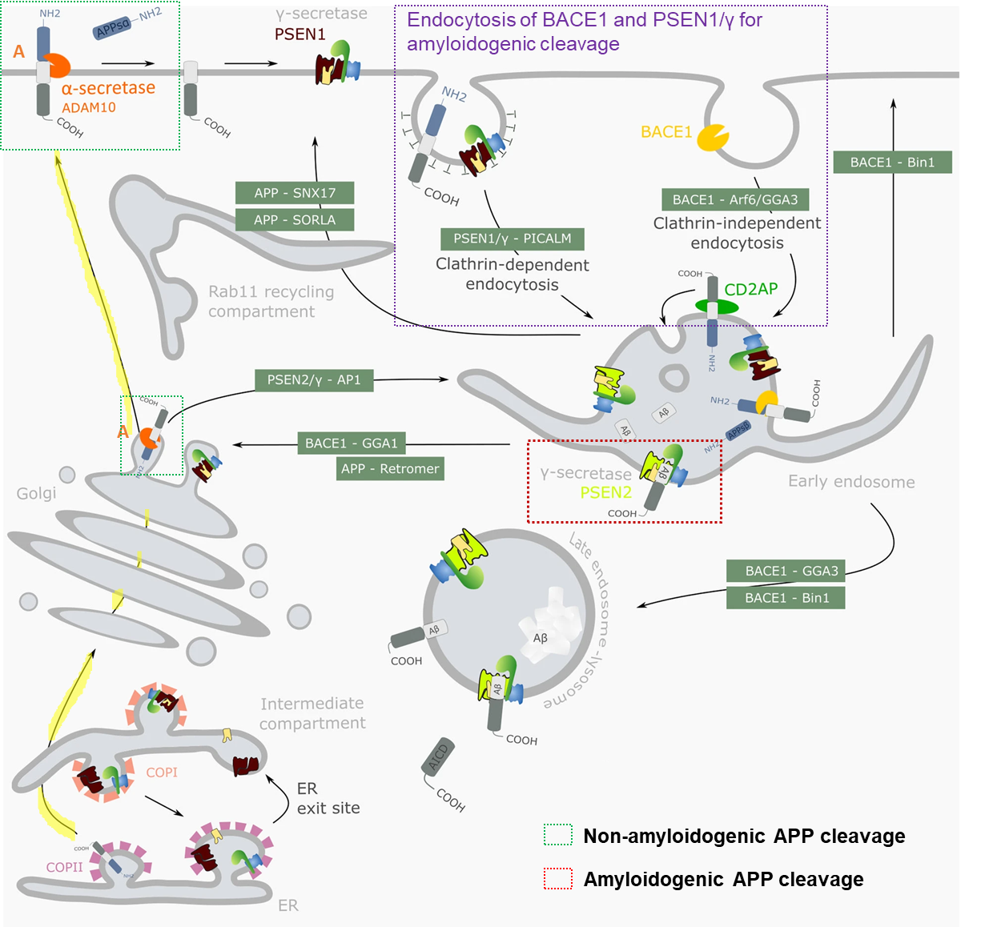

Slide 7
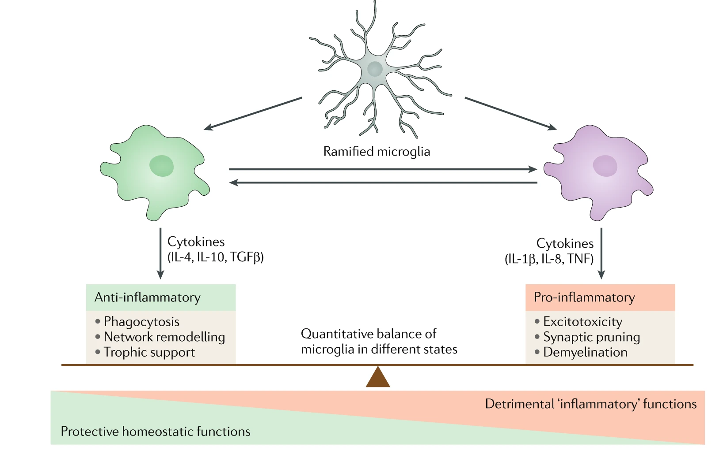
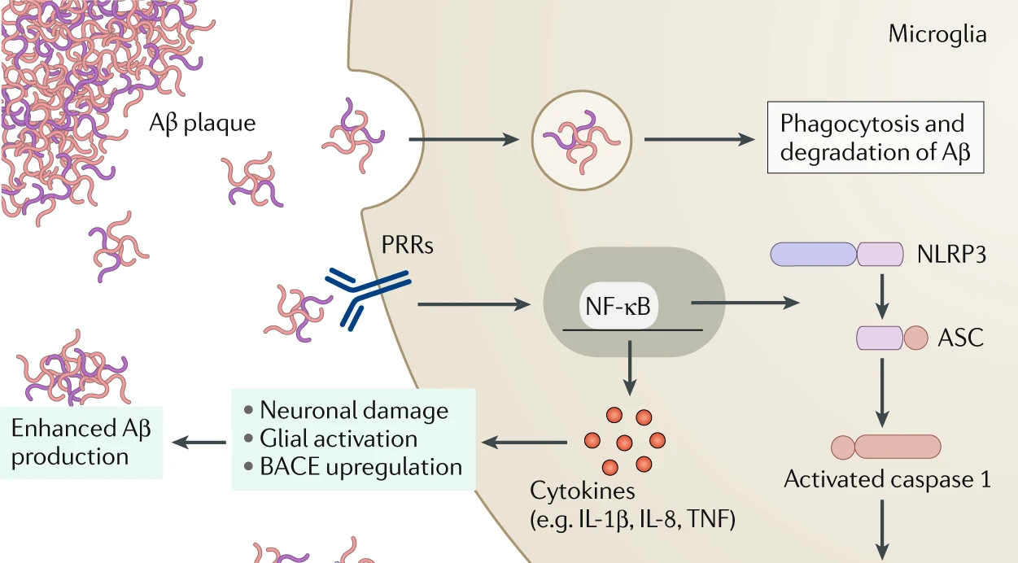
a)
b)

Slide 8
a)
b)

